Slide 1
Mastering Qt 5 GUI Programming
Ben Hoff
www.packtpub.com

Slide 2
2.3 : Custom Models
Diving into Model View
Notes:
The name of the section would be mentioned here.

Slide 3
What We’ll Learn
Custom Models
Implement Custom List Model
Model/Data Relationship
Why create our own?
Subclass a QAbstractListModel
Chosing the Model subclass
Notes:
[Mandatory Slide]
This is a sort of a road map to get introduced to the topics of the section and their title. Instead of putting them as straight bullets, we can show a learning path.

Slide 4
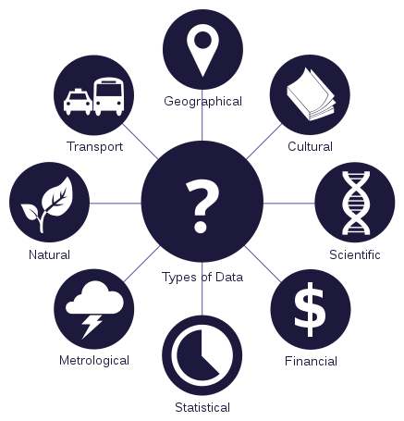
Why Create Custom Models?
Data is:
Complex
Multiple Sources
Dynamic
Expensive

Slide 5
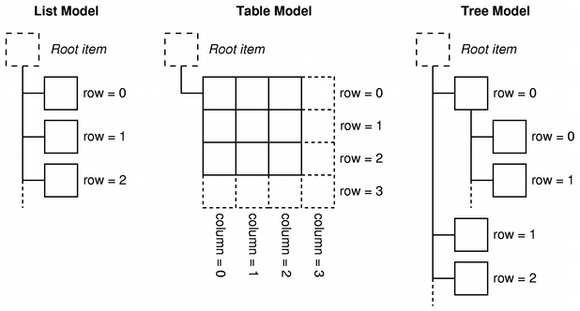
Model/Data Relationship
QAbstractListModel
QAbstractTableModel
QAbstractItemModel
Notes:
This slide, like mentioned above is for multiple pointers. The information above covers the types of information that can be used in this slide

Slide 6
What We Learned
Custom Models
Implement Custom List Model
Model/Data Relationship
Why create our own?
Subclass a QAbstractListModel
Chosing the Model subclass
Notes:
[Mandatory Slide]
This is a sort of a road map to get introduced to the topics of the section and their title. Instead of putting them as straight bullets, we can show a learning path.

Slide 7
Tree View
Diving into Model View
Notes:
[Mandatory Slide]
Here the name of the next video needs to be mentioned. The narration as you guessed it would be just letting the viewer know exactly where we are at and what we’d be taking over next! ☺

